Slide 1
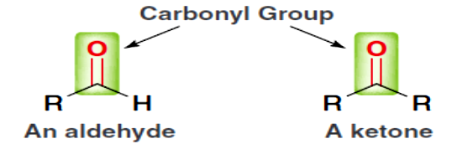
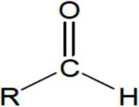
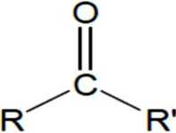
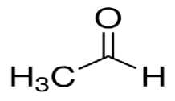
AlKarkh University of Science College of science First year level
General chemistry Labs
Supervisor: Dr. Mohammed Abdul Baset Assistant: Anssam Dhaher Huessin
Lab -12-
Identification of Ketones and Aldehydes
> Aldehydes and ketones both contain the carbonyl group.
> A carbonyl group is a carbon atom double bonded to an oxygen atom.
> The carbon and oxygen in the carbonyl group are SP¹ ²-hybridized, with bond angles of 120°.
> The difference between aldehydes and ketones is the location of the carbonyl group.
> In ketones, two carbon groups are attached to the carbonyl carbon, while in aldehydes at least one hydrogen is attached to the carbon.
aldehyde
ketoue
1. Iodoform (triiodomethane ) CHI3 Test for Methyl Ketones
> Methyl ketones (containing a methyl group attached to the carbonyl), but not other ketones, are oxidized by iodine (I2) in aqueous sodium hydroxide (NaOH).
> The ketone is oxidized to a carboxylic acid; yellow iodoform also forms. It is the yellow iodoform (CHI3) that is indication of a positive test.
> The formation of a yellow precipitate is the indicator that a methyl ketone is present.
> Acetaldehyde, but not other aldehydes, gives this test owing to its structural similarity to methyl ketones.
36

Slide 2
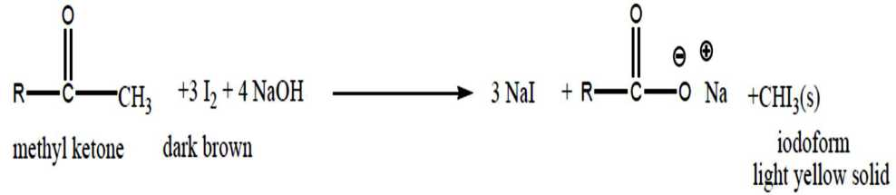
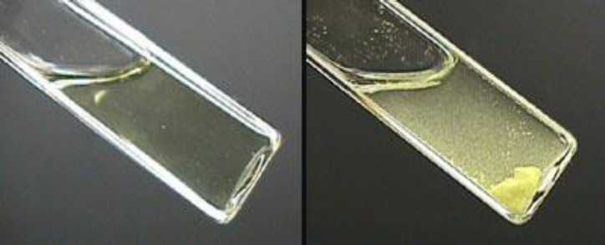
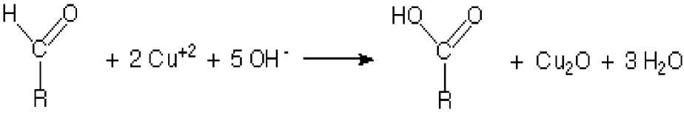
Materials
Test tubes from part, dropper, 10% NaOH, warm water bath, and iodine test reagent.
Method
1. Place 2 mL of water in a test tubes.
2. Add 5 drops of acetone.
3. Add 10 drops of 10% NaOH to a test tube and warm the tube in a warm water bath to 50-60°C.
4. Add 20 drops of iodine test reagent. Look for the formation of a yellow solid precipitate. Record your results.
2. Oxidation of Aldehydes and Ketones (Benedict’s test)
> Aldehydes are oxidized using Benedict’s solution, which contains cupric ion, Cu²+.
> Because ketones cannot oxidize, this test can distinguish aldehydes from ketones.
> In the oxidation reaction, the blue green Cu²+ is reduced to cuprous ion (Cu+), which forms a reddish-orange precipitate of Cu2O.
Ketones + 2 CU+² + 5 OH⁻ → No reactions
Materials
Test tubes, unknown, benedict’s reagent (sodium citrate < 20%, sodium carbonate 10%, copper II sulphate < 2%), droppers, boiling water bath.
37

Slide 3
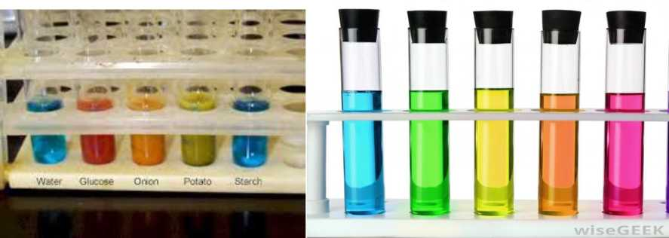
Method
1. Place 10 drops of unknown in a clean test tube.
2. Add 2 mL of Benedict’s reagent to test tube.
3. Place the test tube in a boiling water bath for 5 minutes.
4. The appearance of the red-orange color of Cu₂O indicates that oxidation has occurred. Moderate amounts of Cu₂O will blend with the blue Cu²+ solution to form green or rust color.
38

